Slide 1

Using social media for actionable extreme weather event surveillance
Project 2.
Group 1
Team Members:
Aline Jaimes, Adelia Manuel, Iretemi Adelaja, John kNight
Data analytics bootcamp Rice University 12/02/2019

Slide 2
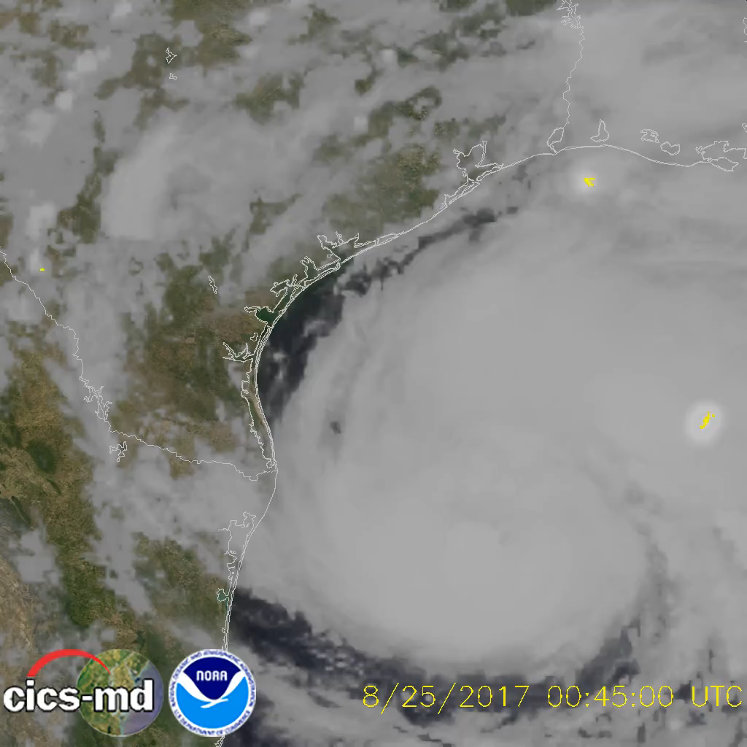
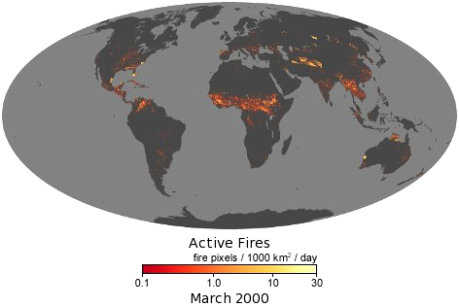
Project Description
Motivation. In the occurrence of an extreme weather event, such as flash flood, fires, snowstorm, heat wave, etc. the warnings from governmental and private sources are not always updated in near-real-time. This makes it difficult for communities, first responders, citizens in general to prepare or better respond to an extreme weather event.
Research Question: Can “listening” to social media help improve monitoring of extreme weather events?
Time Frame: 01/01/19- Present
What is extreme weather? Unexpected, unusual, unpredictable, severe or unseasonal weather.
Above. Hurricane Harvey Above. Droughts USA 2019 Above. Wildfires 2000-2019

Slide 3
Project Description
GOAL: Monitoring dashboard from social media using targeted hashtags with binning threshold.
Coding approach
Front-end – Html, Leaflet
Back-end – Java and Python
Data munging techniques
Web-scrapping of social media using common hashtags to identify #Extreme Events, #SevereWeather, #Floods, #Wildfires
Mongo Database- Mlab
Information transfer from database to html
Map data with Leaflet
JS library - Anime
Final visualization.
https://project2rice.herokuapp.com/

